Slide 1
SMOCK Lock
Group 39
Kenneth McDonald
Gabriel Couto
Eric Sayegh
Matthew Navarro

Slide 2
Motivation
Providing safety and security to homeowners.
Utilizing the app, the homeowner would be able to unlock the door from anywhere as well as designate keys.
Provide a security feature that will use facial recognition to detect who is at the homeowner’s door.
Similar products in the market offer minimal features and remain expensive.
To apply Computer Vision and App development from our Computer Engineering Experience to a project.

Slide 3
Objectives
Our smart lock should contain a secure system that provides multiple forms of authentication/security
Our app will allow the homeowner to approve access to people at the door without them having too physically be there
Our smart lock should be affordable and competitive with other smart locks
Our functionality and features of the app and lock should be seamless and easy to understand.

Slide 4
Specs and Requirements
Component | Measure | Description
Power Supply | Power Capacity | Last for at least a week before it needs a recharge
Size of Lock | Size | To keep within a 6" by 6" box
Speed of Facial Recognition | Time | To have a positive ID or a false provided within 10 seconds
Speed of Fingerprint Scanner | Time | To have a positive ID or a false provided within 10 seconds
Software/Network Security | Standards | Follow the ETSI EN 303 645- a global standard for IOT security.
Sensor/Lock Security | Methods of Recognition | Provide the User with 3 forms of recognition that individually provide security for the entry

Slide 5
Project Block Diagrams

Slide 6
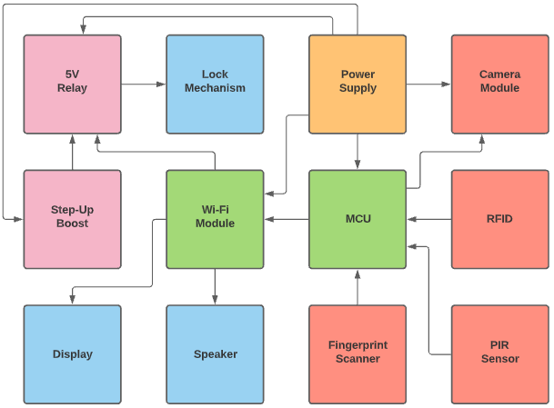
Hardware Block Diagram

Slide 7
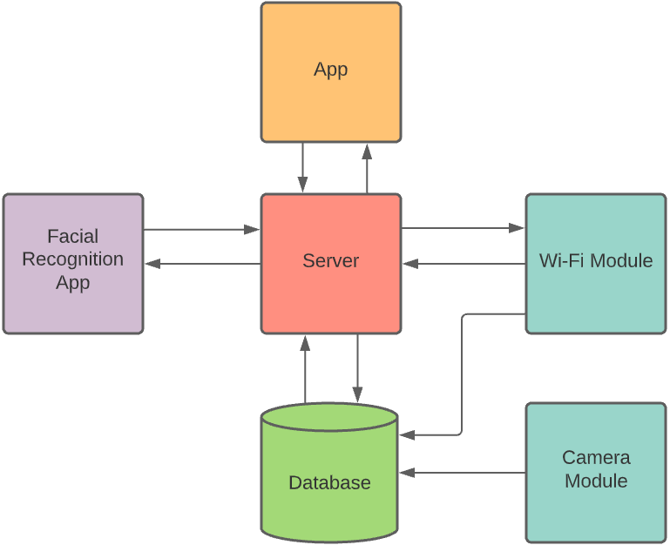
Software Block Diagram

Slide 8
Software Implementation

Slide 9
Software Approach
To conduct operations such as facial recognition locally would increase the cost of the lock by a large amount.
Thus, we decided to conduct most of the computational processing server-side in the cloud. Allowing us to not have to spend as much on a powerful microcontroller and will allow us to conserve power.
This influenced us to use a MERN technology stack to provide all the necessary tools to build the lock software, mobile application, server, and APIs.

Slide 10
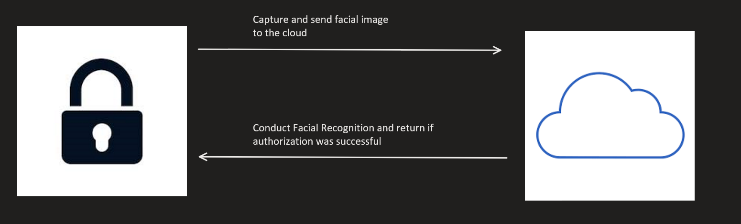
Facial Recognition
Facial recognition is conducted by capturing an image with the ESP32-CAM on the lock, then sending the facial image through an http request to one of our APIs. This API will run a script that conducts facial recognition against the facial images stored in the database. The API will return whether authentication was successful or not to the lock.

Slide 11
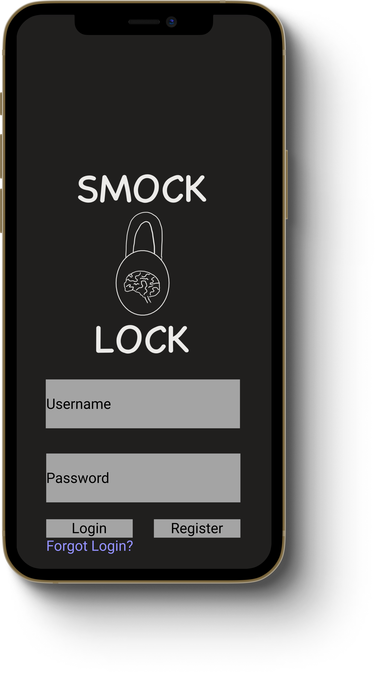
Mobile Application
The mobile application will allow the user to conduct the following task:
Register an account that allows the user to link their lock for configuration and customization.
Setup facial recognition.
Create E-Keys that can be shared with guest for access.
Add/remove other accounts as guest.
Configure whether facial recognition, fingerprint recognition, RFID scan, or E-Key is required for authorization.
When lock detects a person, owner will receive an image of who is at the lock.

Slide 12
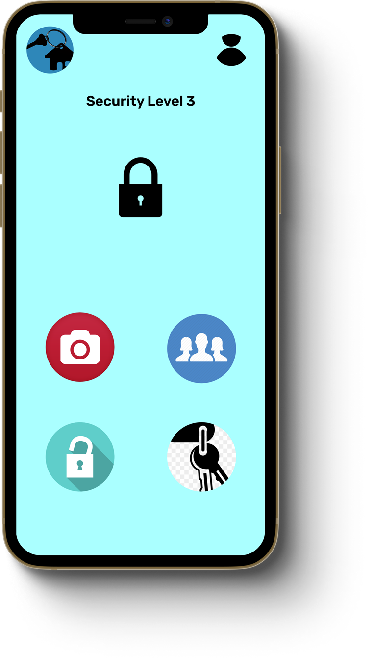
Home Screen
Access your own E-Key for the lock
User Settings
Tier Level
Lock Status
Live-feed from camera on lock
Authorized Users
Unlock and lock via app
Access a list of guest E-Keys

Slide 13
Settings
Configure Facial and Fingerprint Recognition
Configure Lock Setup
Choose what notifications to receive.

Slide 14
Authorized Users
Status of facial and
fingerprint recognition setup.
Edit/delete users from authorized list.
Invite family and friends to setup an authorized account.

Slide 15
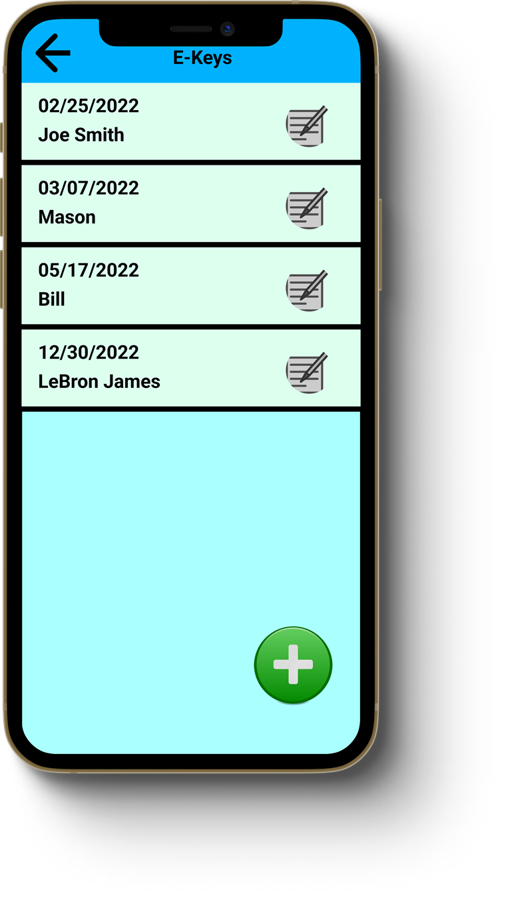
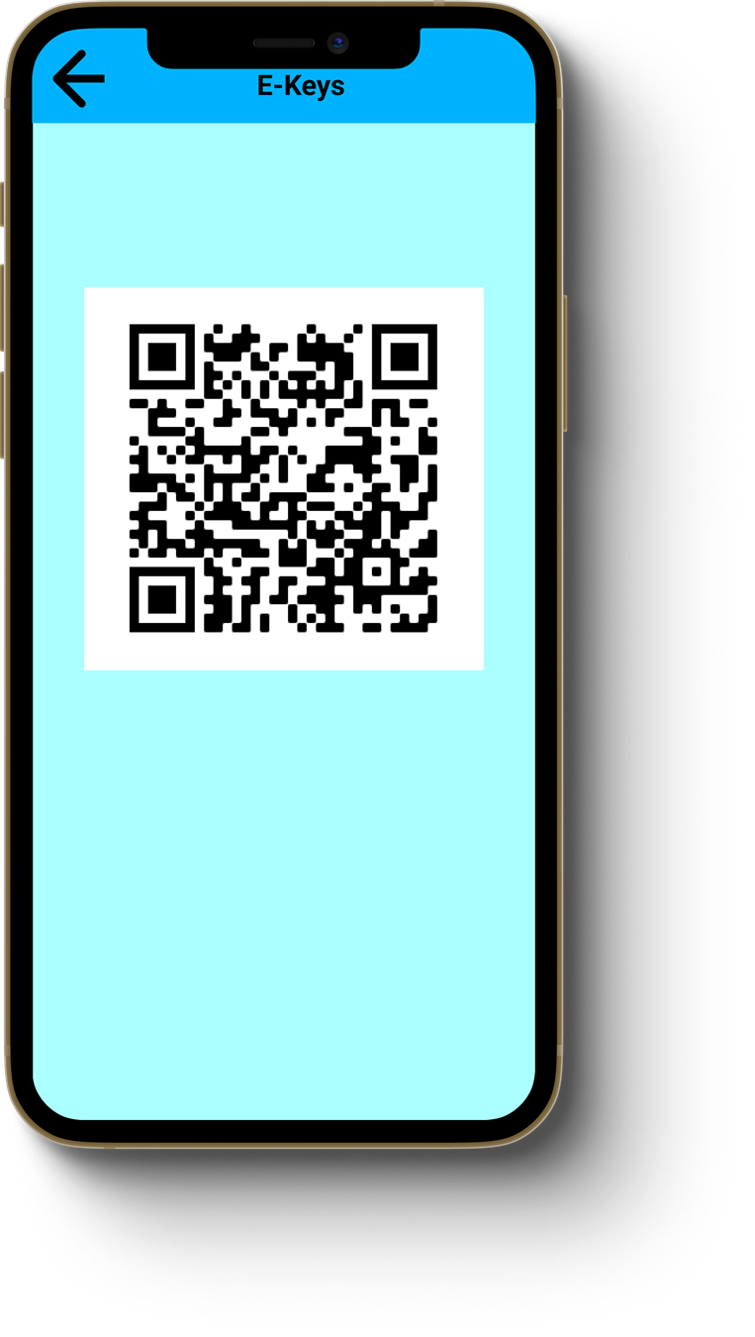
E-Keys
Keep track of expiration date and name of guest E-keys given out.
Edit/Delete E-keys at anytime
Scan QR code as a key for the lock.
Create a new guest E-key.

Slide 16
Database
The database will be need to store all biometric information to allow for the comparisons to be made during authentication. We chose MongoDB, a NoSQL database program, as our database.

Slide 17
Major Component Selection

Slide 18
MCU (Atmega328p)
The main purpose for the microcontroller will be used to communicate sensor data with the Wi-Fi module.
Since most of the computation will be server-side we have chosen to go with the Atmega328p.
Advantages:
Huge Open-Source support and Documentation, allows for simplicity in programming.
23 I/O Pins that can be used with our sensors which is what is a bit more than required for our Lock.
Low priced around $2.82
Can use SPI, UART, and I2C
Price | ~ $2.82
CPU | 8-bit AVR RISC CPU On-chip 2-cycle multiplier
Flash Memory | 32 KB
SRAM | 2 KB internal
Registers | 32 8-bit general purpose working registers
I/O Pins | 23

Slide 19
Wi-Fi Module (ESP8266)
The Wi-Fi module will be used to communicate sensor data from the microcontroller to the server and will be used to send the signal to unlock the door.
We were looking at the ESP8266, ESP32 and the CC3120. Since we do not need too much processing power on the Wi-Fi chip itself, we ultimately went with the ESP8266.
Advantages:
Lowest Price
Lowest Power Consumption
Smallest Size
Communicates through UART
Can complete HTTP requests
Price | $1.60
CPU | Tensilica L106 32-bit processor
RAM | < 50 KB
Other Memory | 16 MB External Flash
Operating Current | ~ 80 mA
I/O Pins | 17
Size | 5mm x 5mm

Slide 20
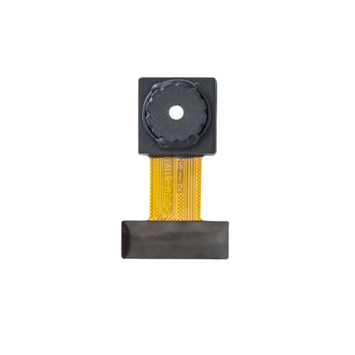
Camera (OV2640)
The main purpose for the camera module is to take images of guests at the door and store in the database to later be used for facial recognition.
We have decided to go with the ESP32-CAM module that uses the OV2640 for image processing and uploading.
Advantages:
Lowest price
Allows for Facial Recognition in terms of the Image Quality.
Other comparable features were identical across camera's we looked at.
Price | ~$1 - $5
Image Sizes | UXGA, SXGA, SVGA, any size scaling down to 40x30
Image Transfer Rates | 60fps(CIF), 30fps(SVGA), 15fps(UXGA,SXGA)
Image Quality Controls | Color Saturation, Gamma, Sharpness, Lens Correction, Noise and White Pixel Cancelling, 50/60 Hz luminance Detection
Operating Modes | Video and Photo

Slide 21
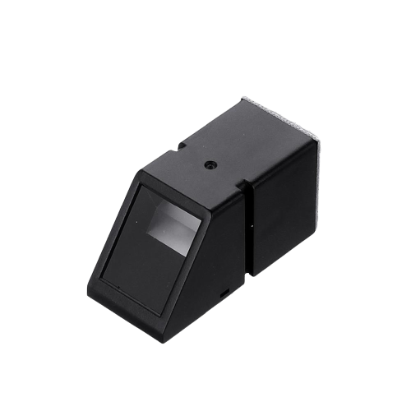
Fingerprint Sensor (AS608)
The fingerprint sensor will be used as another tier of security for the lock.
We were looking at optical and capacitive fingerprint sensors and ultimately decided on the AS608 optical fingerprint sensor.
Advantages over other sensors:
3x the storage size for fingerprints
Faster Search Time
Rectangular shape will allow for better placement on the enclosure.
Price | ~$1 - $5
Communication Method | UART
Storage Capacity | 240 fingerprints
Search Time | < 220 ms
Size | 15mm x 17mm
Notes:
The fingerprint sensor will be used fingerprint recognition as another tier of security on the lock. The selection came down to the AS608 Optical fingerprint sensor and the ID809 capacitive fingerprint sensor. We have decided to go with the AS608 Optical fingerprint sensor. While the ID809 is cheaper and similar to the AS608, the AS608 has three times the storage, a faster search time, and the rectangular size will be able to make better use of space for component layout in our custom enclosure.

Slide 22
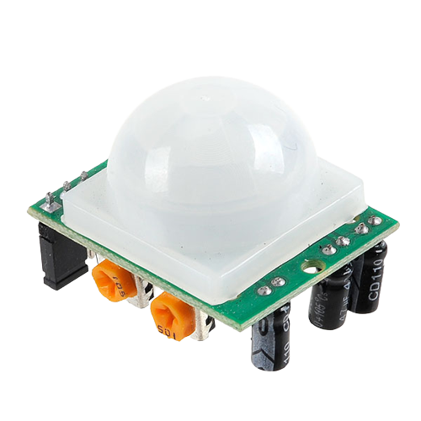
PIR Sensor (HC-SR501)
The PIR sensor will be used to sense when a person approaches the door and to transition the system from low-power mode to normal operation.
We were deciding between and HC-SR501 PIR sensor and a AM312 PIR sensor and ultimately went with the DIYmall HC-SR501 PIR sensor.
Advantages:
Adjustable sensing range
Adjustable delay time
Lowest Price
More documentation than other sensors
Price | ~$5
Quiescent Current | < 50 uA
Delay Time | 5-18 seconds
Range | Adjustable
Block Time | 2.5 seconds

Slide 23
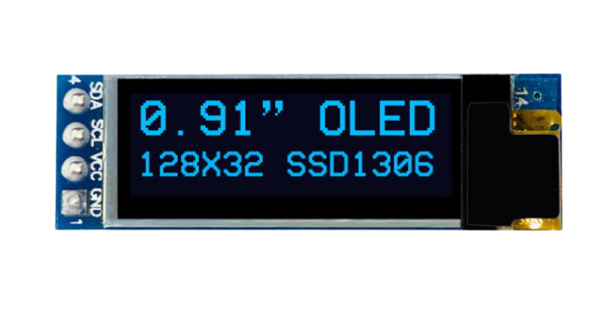
Display (OLED)
The display will be used to provide visual instructions to a person at the door.
We were deciding between an LCD display and an OLED display and ultimately went with the OLED. The OLED is about $2 more than the traditional display but the advantages of the OLED make the price difference worth it.
Advantages:
Response time > LCD
Power Consumption < LCD
Every pixel on the screen can be used
Small size
Price | ~$6
Resolution | 128 x 31
Backlight | Self -Illuminated
Response Time | ~ .01 ms
Size | .91 inch

Slide 24
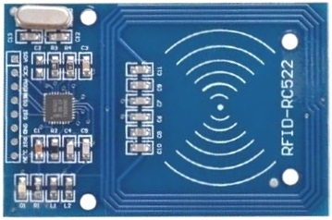
RFID (MFRC522)
The purpose of the RFID is to serve as another tier of security or as a backup key if necessary.
We decided to go with an RFID kit that is based on the widely used Phillips MFRC522 Chip.
Specifically, we decided to go with the MiHappy RFID kit. This kit is very similar to other RFID’s using the same chip, but this specific kit has a farther read range than others.
Price | ~ $10
Interface | SPI
Read Range | ~ 0 – 60 mm
Operating Frequency | 13.56 MHz
Input Voltage | 3.3V

Slide 25
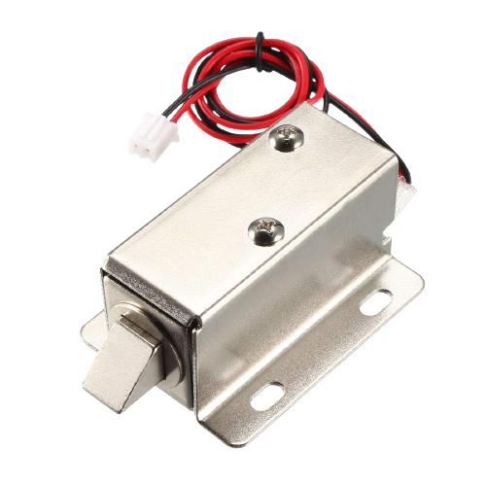
Locking Mechanism (Electric Solenoid)
For our locking mechanism, we have decided to go with an electric solenoid due to its simplicity, size, and ease of integration with the rest of our components.
Specifically, we have chosen a latch style solenoid. When constructed we will be able to send a digital signal to the relay which will then supply power to the solenoid to unlock or lock the door.
Price | ~ $3
Input Voltage | 12V
Input Current | 350mA
Solenoid Style | Latch
Size | 17mm x27mm x 15mm

Slide 26
Schematic and PCB

Slide 27
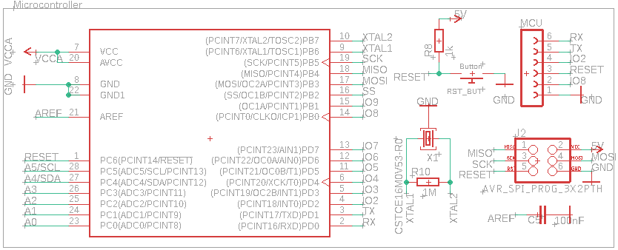
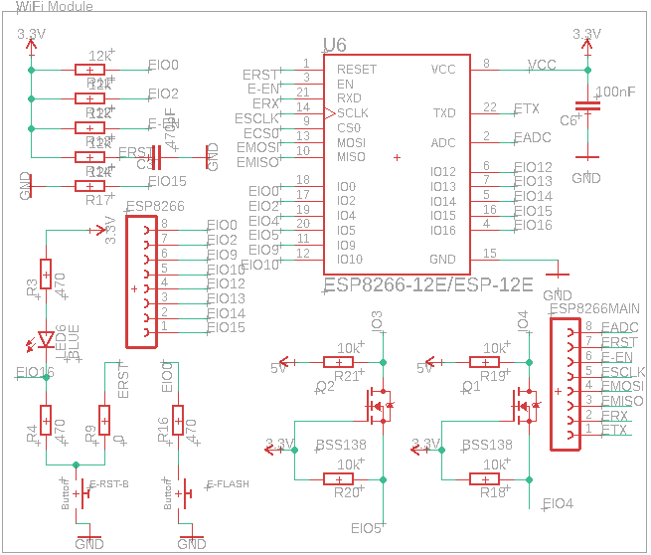
Schematic (Microcontroller and Wi-Fi Chip)

Slide 28
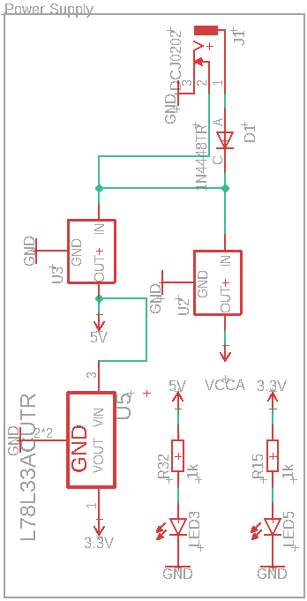
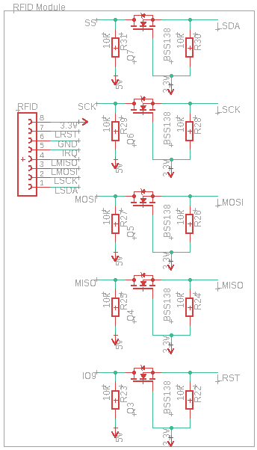
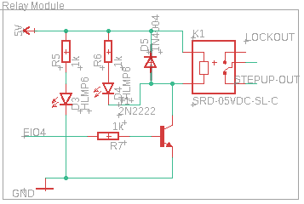
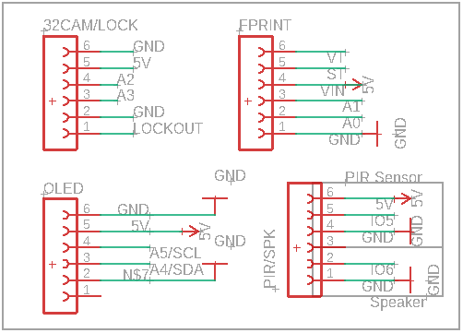
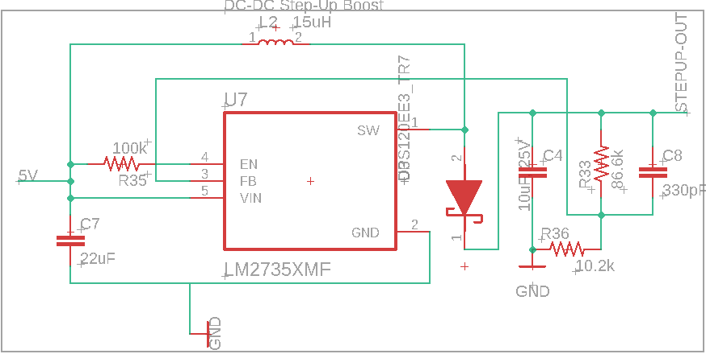
Schematic (Sensors and Power Modules)

Slide 29
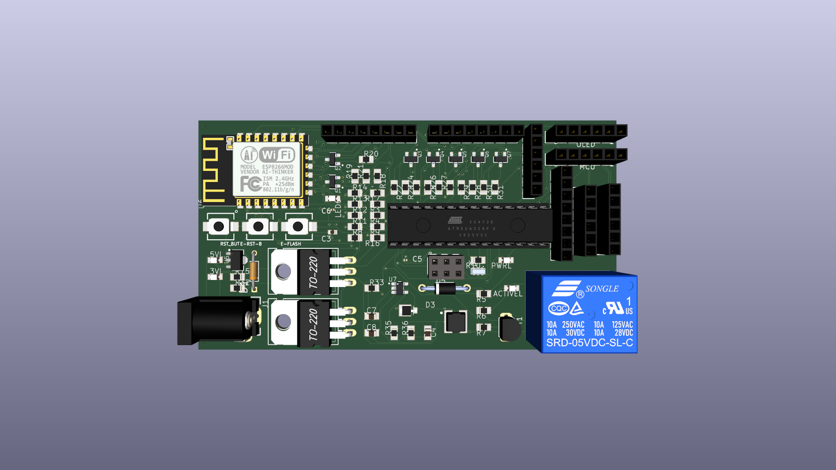
PCB Layout
Wi-Fi Module
Sensors/MCU Headers
Reset/Flash Buttons
MCU
5V Relay
Voltage Regulators
Power Input
DC-DC Step-Up Boost

Slide 30
Enclosure and 3d models

Slide 31
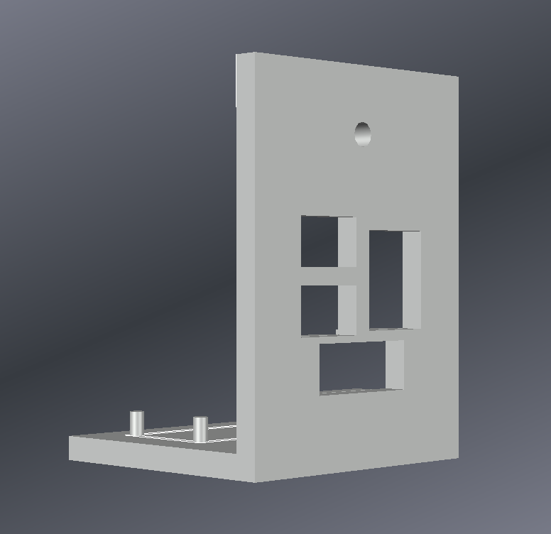
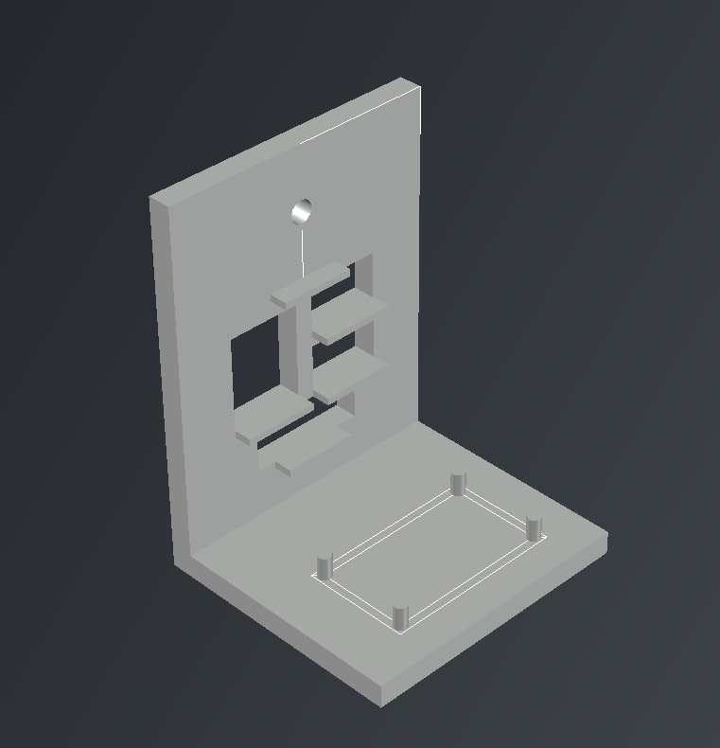
Initial models for enclosure

Slide 32
Standards, Constraints, and Design Issues

Slide 33
Standards for Coding and other Guidelines
Most modern codes have a detailed guideline that users to follow when coding and is what we will follow for coding in each language. A list of the guidelines we followed can be found on our Project Documentation Table 4.2.
SO/IEC 12207:2008 Systems and software engineering — Software life cycle processes- This standard shows a flowchart of the development of software including development, maintenance, and operation. Along with mentioning how external software should be handled and integrated in the system.

Slide 34
Economic Constraints
The most pressing economic constraint will be the acquisition of parts that are not only cost effective but also designed for longevity.
The project is also self-financed so some parts may need to be found cheaper or to look for other alternatives for the system.
A general shortage of circuit boards in the United States which drastically lowers the number of boards that can be realistically used.

Slide 35
Design Issues
Having Multiple Chips on a single board, may cause some minor inconveniences/complications when attempting to program them.
We need voltage regulators to ensure that all the components are getting their recommended voltage levels, this will ensure that components won’t cause a surge in our system.
Two components with different voltage requirements may cause problems during transmission of data which required us to implement logic-level converters.
When uploading images to a database, we have decided to convert images to Base64 in order to overcome the issue of storage capacity when uploading a PNG or JPEG.

Slide 36
Administrative Content

Slide 37
Work Distribution
 | Matthew Navarro | Kenneth McDonald | Eric Sayegh | Gabriel Couto
Backend | ✓ | ✓ | ✓ | ✓
Frontend |  |  | ✓
API | ✓ | ✓ |  | ✓
Database Management | ✓ |  | ✓
Software for Components |  | ✓ |  | ✓
PCB Design |  | ✓

Slide 38
Budget and Financing
Item | Price (Estimated) | Quantity
Power Supply 9V (8 pack) | $11.87 | 1
Wi-Fi Module | $3.49 | 2
Camera | $10.82 | 2
Solenoid Lock | $14.70 | 2
Speaker | $12.00 | 2
Casing | $30.00 | 2
Fingerprint Scanner | $23.99 | 2
PCB | $130.00 | 2
Prototype Parts | $48.00 | 2
Display | $9.49 | 2
RFID | $10.80 | 2
PIR | $10.49 | 2
Total | $363.65 | 23
The price estimate of $363.65 is still our running estimate for the project. This leaves our total for one lock to be $181.25.
We still plan to split the project 4 ways, so we are currently spending $90.91 per member.

Slide 40
Questions?

